Slide 1

ACE: Accessible Care For Everyone
Welcome to ACE, a revolutionary platform designed to empower you with greater control over your health and insurance. ACE is the future of healthcare, making your medical information and insurance policies easily accessible, manageable, and secure.

Slide 2
The Problem: A Fragmented Healthcare System
Inefficient Processes
Administrative Burden
Security Concerns
The current healthcare system often involves fragmented medical records and insurance policies, leading to redundant paperwork, delays, and difficulties in accessing accurate medical history.
The lack of integration places a significant administrative burden on both patients and doctors, wasting time and resources.
Maintaining multiple accounts and platforms for medical and insurance information can pose security risks and make it challenging to protect sensitive data.

Slide 3

Introducing ACE: A Unified Platform
1
Centralized Hub
ACE serves as a centralized hub for all your medical records and insurance policies, providing a single point of access for all your healthcare information.
2
Aadhaar Integration
ACE securely connects your Aadhaar with your medical history, ensuring accurate and reliable data, while maintaining privacy and security.
3
Streamlined Management
ACE simplifies the process of managing your health records and insurance policies, reducing administrative burden and saving you time and effort.
4
Enhanced Convenience
ACE puts all your healthcare information at your fingertips, allowing you to easily view medical records, manage insurance premiums, and access relevant services.

Slide 4
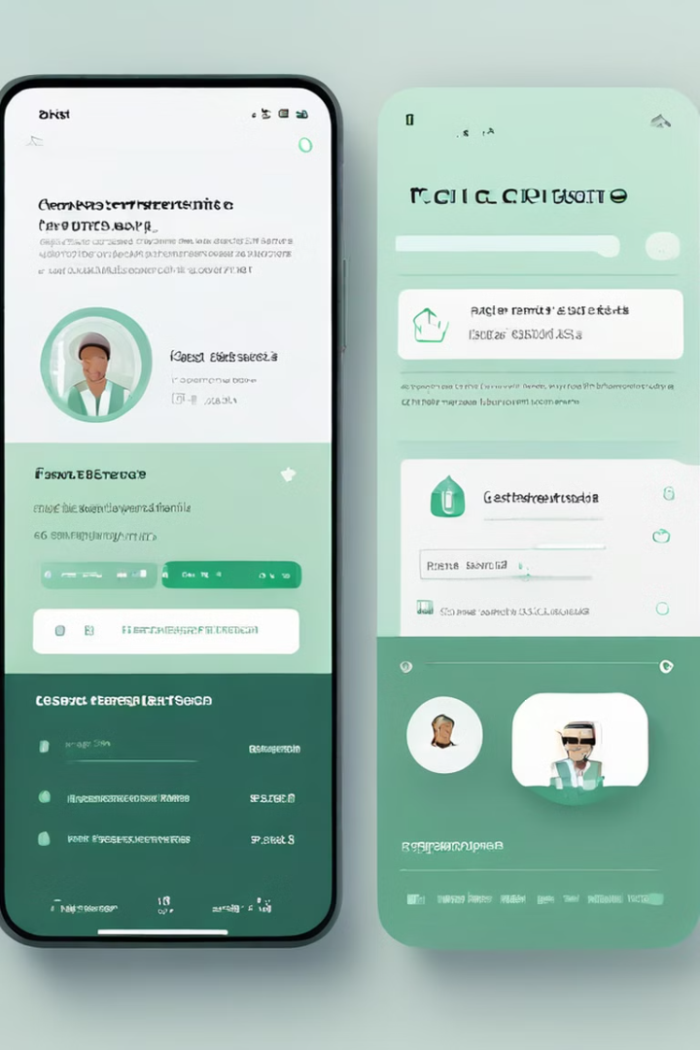
Our Solution: ACE
Secure and Accessible
ACE prioritizes data security and privacy, employing robust encryption and access controls to protect your sensitive information. The platform is easily accessible through web and mobile applications.
Personalized Experience
ACE provides a personalized experience tailored to your specific needs, allowing you to manage your healthcare and insurance preferences seamlessly.
Improved Healthcare Outcomes
ACE empowers individuals to take control of their health and insurance, leading to improved healthcare outcomes by facilitating timely access to accurate medical information and enabling proactive health management.

Slide 5

Benefits for Individuals
Easy Access
Improved Healthcare
Access your medical records and insurance information anytime, anywhere, from your smartphone or computer.
Make informed decisions about your health and insurance with easy access to accurate and comprehensive medical records.
1
2
3
4
Time-Saving
Peace of Mind
Reduce paperwork and simplify the process of managing your health and insurance, freeing up your time for other important things.
Rest assured knowing your health and insurance information is secure and readily available when you need it.

Slide 6





Benefits for Healthcare Providers
Accurate Patient Information
Gain access to comprehensive and up-to-date patient medical records, streamlining diagnosis and treatment planning.
Reduced Administrative Burden
Spend less time on paperwork and administrative tasks, allowing you to focus on providing quality care.
Improved Patient Communication
Facilitate seamless communication with patients, sharing important information and updates in a secure and efficient manner.
Enhanced Patient Care
Improve patient care by enabling better coordination and collaboration among healthcare providers, leading to more informed and personalized treatment plans.

Slide 7

Benefits for Insurance Companies
Faster Claim Processing
Access to accurate patient medical history simplifies claim verification and reduces processing time.
Reduced Fraud
Enhanced data security and access control measures help minimize fraudulent claims.
Improved Customer Service
Provide better customer service by offering quick and efficient access to insurance information and claim status updates.
Personalized Services
Leverage patient medical data to offer personalized insurance plans and services tailored to their specific needs.

Slide 8

Revenue Sources of ACE
1
Monthly Subscription Fees from Users
2
Subscription Fees from Hospitals
3
Fees Charged to Insurance Companies
Users pay a monthly fee for access to ACE's comprehensive healthcare platform.
Hospitals subscribe to ACE to streamline their operations and improve patient care.
Insurance companies pay fees to advertise on ACE and reach a wide customer base.

Slide 9





ACE: A Vision for the Future
Secure Data
Protecting your information is paramount. ACE uses advanced security measures to safeguard your medical records and insurance data.
Easy Access
ACE is designed to be user-friendly and accessible to everyone, regardless of technical expertise. It's available on multiple devices, making it convenient to use anytime, anywhere.
Unified Platform
ACE seamlessly integrates your medical history and insurance policies into one centralized platform, simplifying healthcare management.
The Future of Healthcare
ACE is more than just a platform; it's a vision for the future of healthcare, driven by innovation, accessibility, and empowerment.

